Slide 1
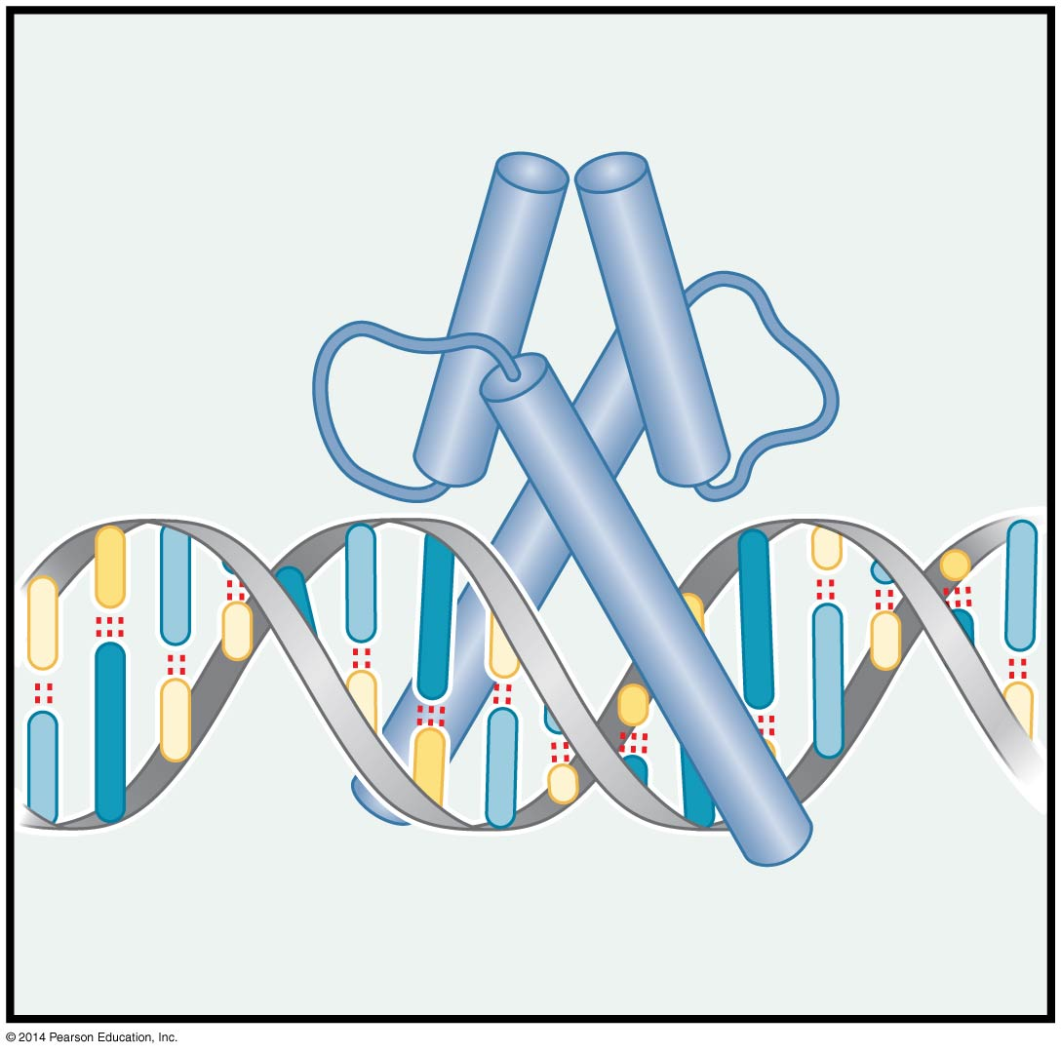
Transcriptional Regulation in Eukaryotes
BT 454
Chapter 19

Slide 2
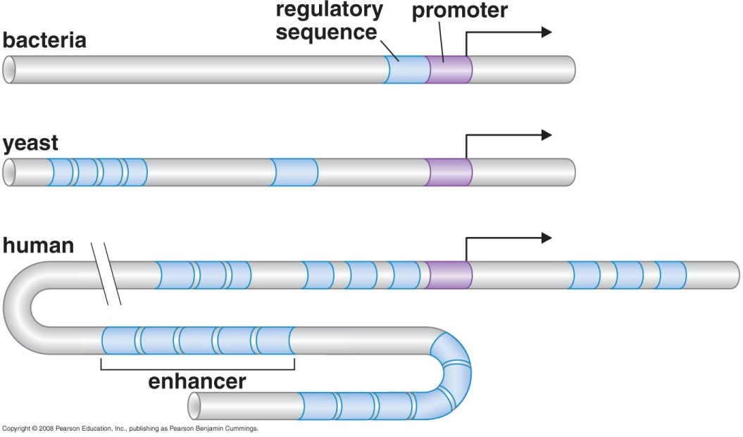
What is extra in Eukaryotes
Nucleosome and their modifiers
  Another level of regulation
  New way of repression by gene silencing
More regulators and more extensive regulatory sequences
  Promoter
  Regulatory sequences
  Insulators
Splicing
silencing
Why do Eukaryotes have different regulatory
Sequences for same gene?
Notes:
Promoter is where transcriptional machinary binds
Regulator binding sites is the individual binding site
Regulatory sequences the complete collection of regulator binding sites

Slide 3
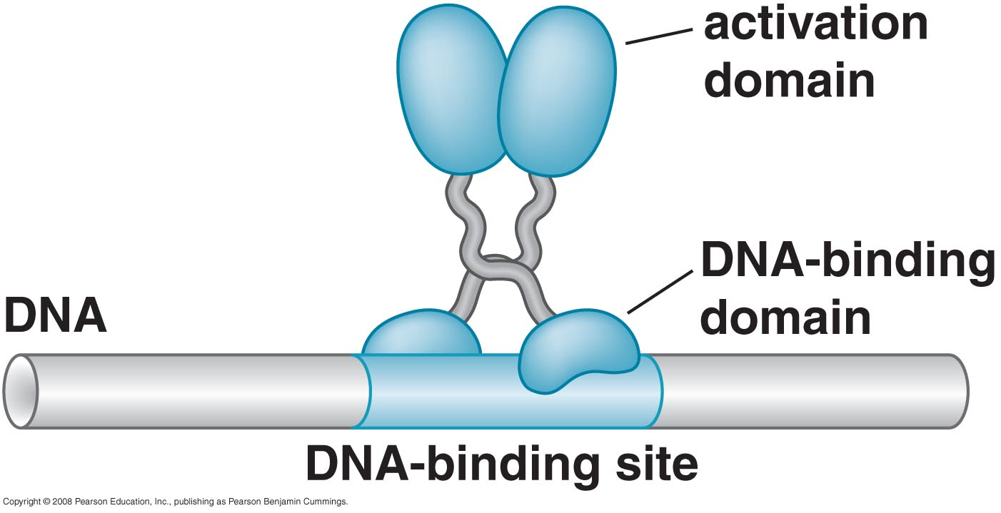
Activators have separate DNA-binding and activating domains

Slide 4
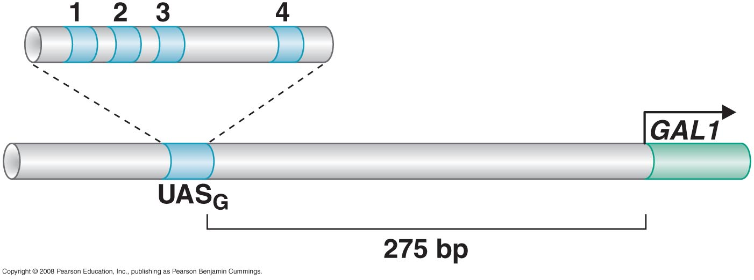
Activators have separate DNA-binding and activating domains
Gal4 activator binds to upstream activating sequence of GAL1 gene

Slide 5
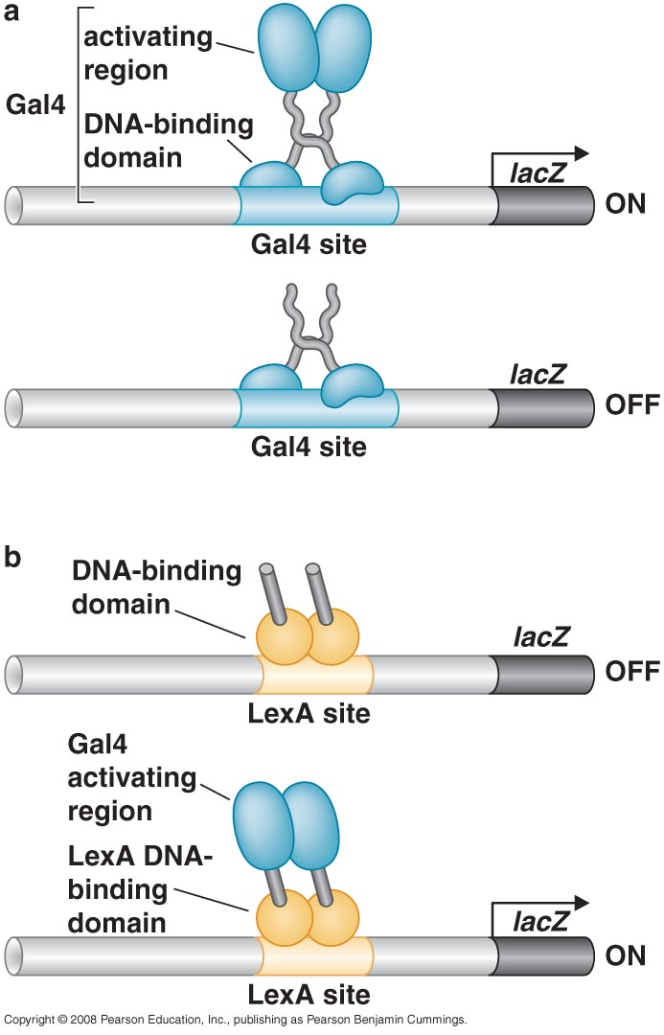
Domain Swap experiments :
Conclusion: activating region & DNA binding domain are separable
These experiments were conducted on higher Eukaryotes with same results

Slide 6
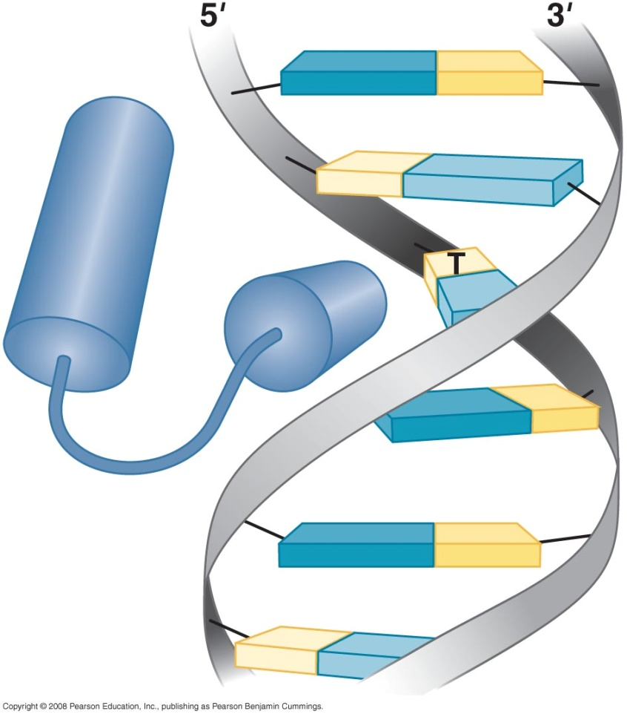
DNA recognition
Same principle in both prokaryotes and Eukaryotes
  Most are HTH
  Recognition by helix into major groove
  Most are dimers
But in Eukaryotes
  DNA binding protein can exist as
  heterodimer or monomer
  Forms other than HTH exist

Slide 7
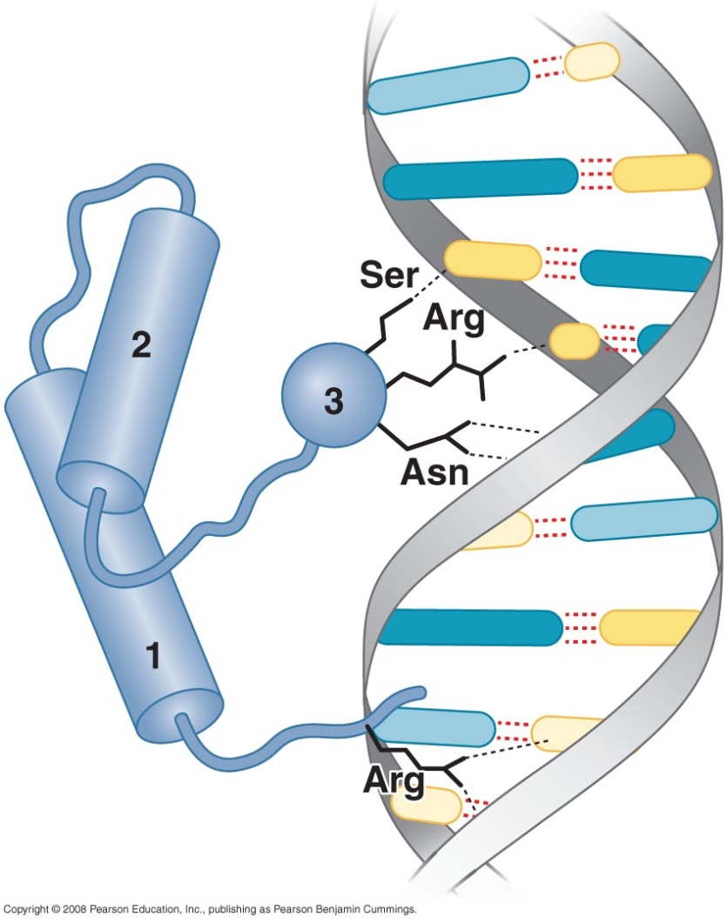
Eukaryotic DNA – binding domains
1- Homeodomain
A class of HTH
Present in all eukaryotes
Consists of 3 helices
  3 is the recognition helix
  Additional contacts with helix 1 at the minor groove
Many bind as heterodimer

Slide 8
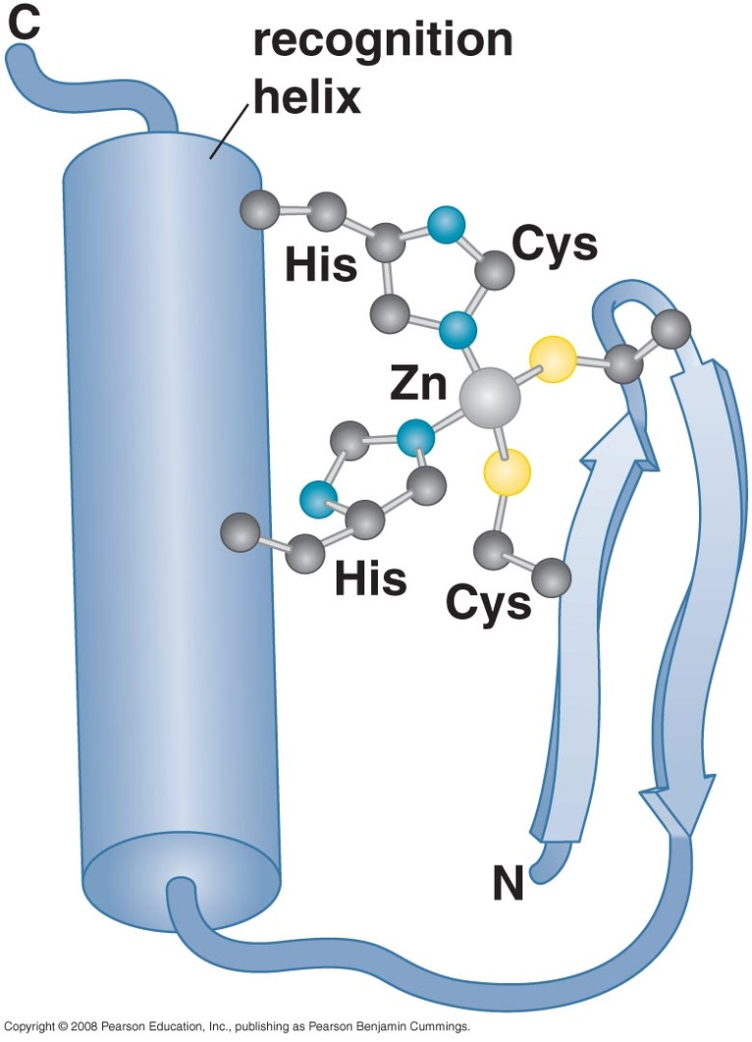
Eukaryotic DNA – binding domains
2- Zinc-containing domain
Zinc atom is important to maintain structure of the protein
Could occur in different forms
  Zinc finger domain (TFIIIA)
  Zinc cluster domain
Some proteins include more than one zinc finger

Slide 9
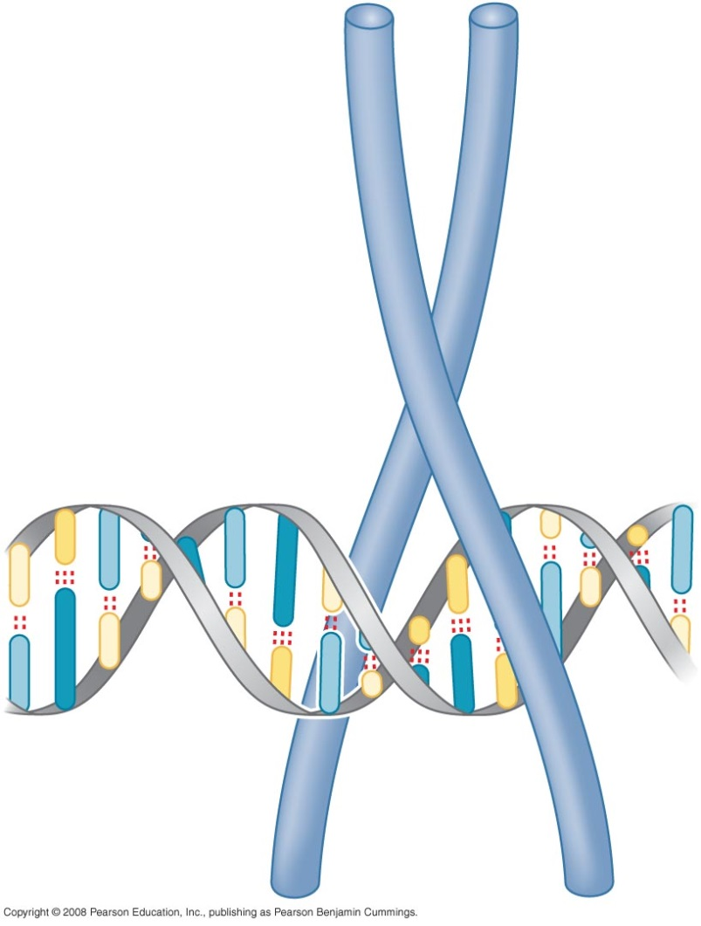
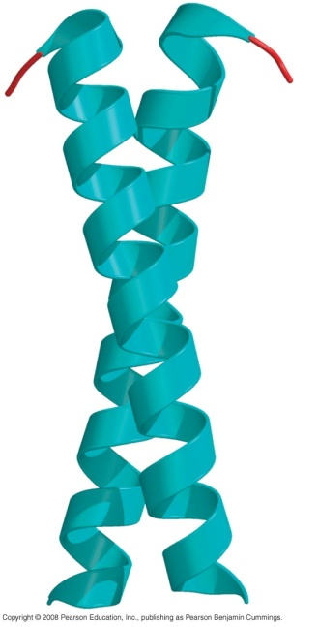
Eukaryotic DNA – binding domains
3- Leucine zipper motif
2 α helices form a pincer like structure
Both α helices interact with DNA
Coil-coil held together by hydrophobic interaction between spaced leucine (or other hydrophobic) residue.
Coiled-coil

Slide 10
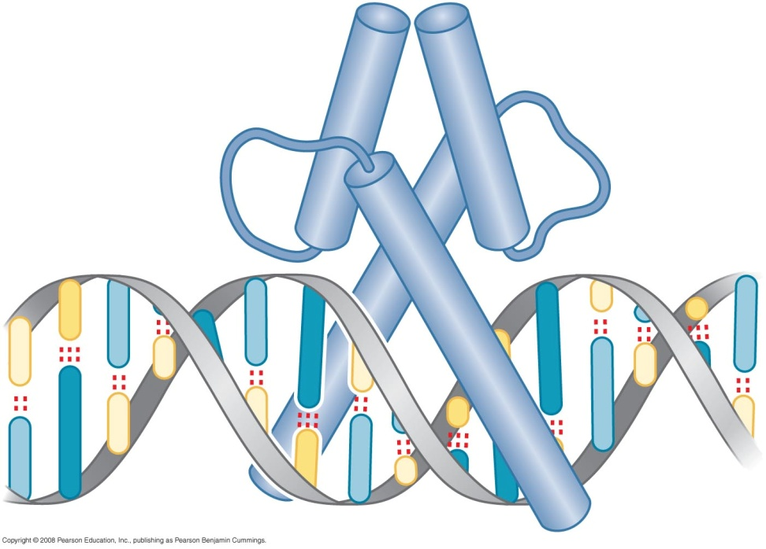
Eukaryotic DNA – binding domains
4- Helix loop helix
Dimerization of two α helices
  DNA recognition helix
  Short helix joined by a loop
DNA recognition loop contain basic
aa → basic HLH = basic Zipper

Slide 11
Eukaryotic DNA – binding domains
5- HMG protein
Interact with minor groove
Highly conserved motif called AT hooks
Alter confirmation of DNA helix
Faciliates higher-order-protein-DNA complexes
e.g: β-interferon enhancesomes
Important role in development : Sox₂ regulator essential for pluripotency of Embryonic Cells.

Slide 12
Activating regions are not well defined structures
They are adhesive surfaces that interact with other proteins
Grouped on the bases of amino acid content
  Acidic / basic
  Hydrophilic / hydrophobic
  Glutamine rich
Confirmed by:
  Effect of mutation on the aa sequence of activating domain
  Consists of collection of small protein
  Fragments of the domain retain fragment of the function

Slide 13
Recruitment of protein complexes to genes

Slide 14
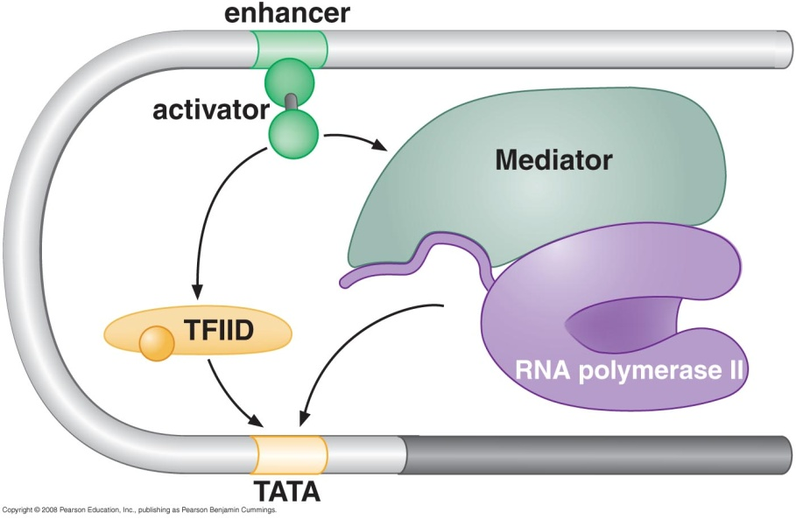
Recruiting transcriptional machinery
Unlike prokaryotes activators do not recruit RNA polymerase directly
Activators recruits other proteins
  Transcription factors (TFIID)
  Mediator
  Nucleosome modifiers
  Polymerase initiation & elongation factors
Activators can also induce allosteric changes

Slide 15
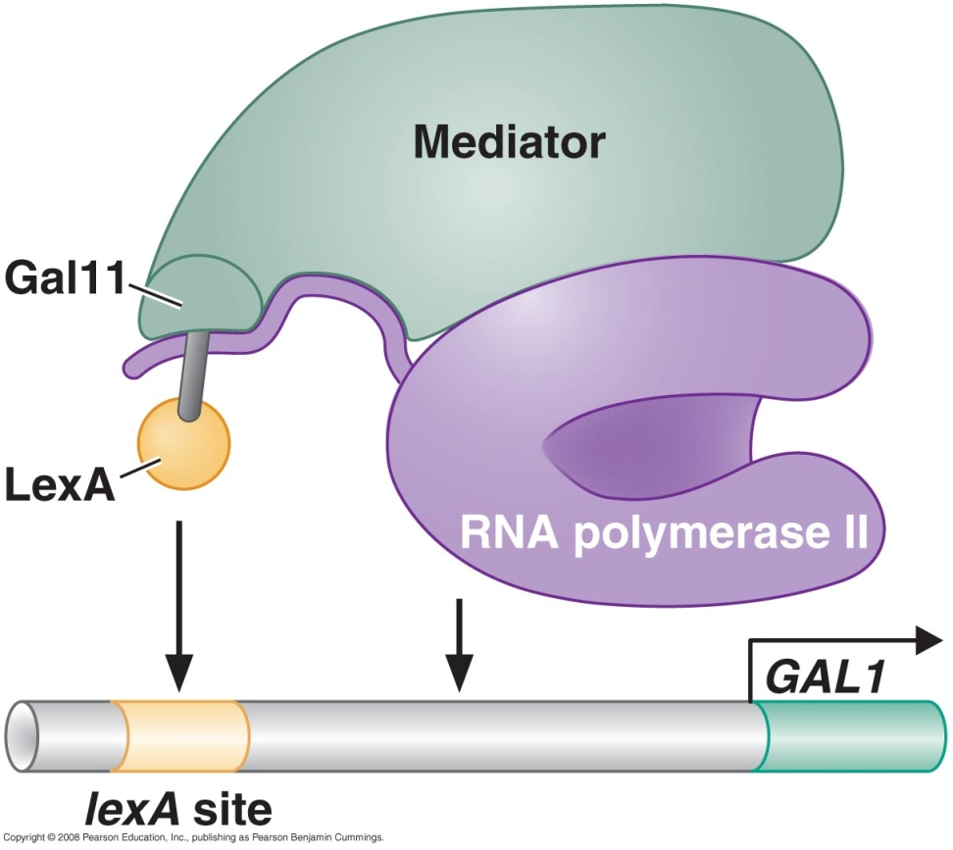
Activation of transcription is through direct tethering of mediator
The aim of these proteins is to recruit RNA polymerase to promoter
Bypass experiment
Notes:
GAL1 gene normally activated by gal4 protein

Slide 16
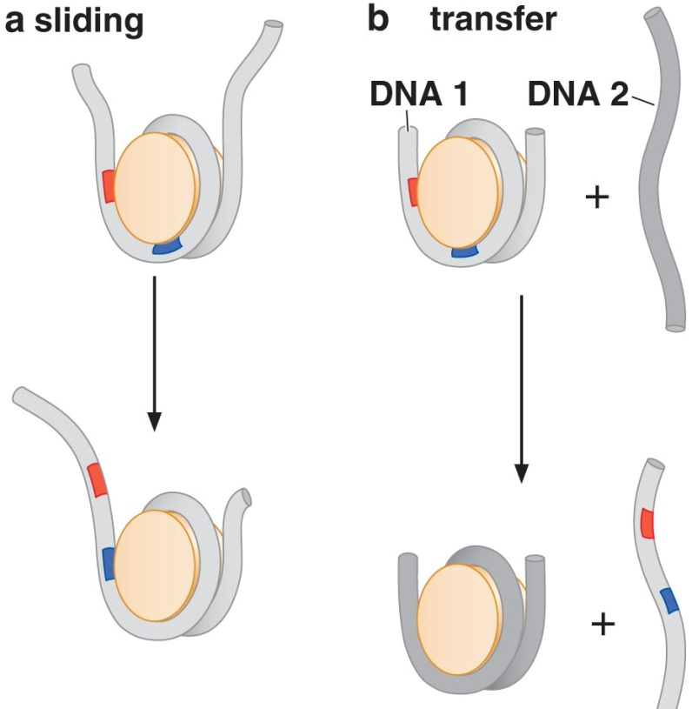
Activators recruit nucleosome modifiers
Two groups of nucleosome modifiers
  Nucleosome remodelling complexes [SWI/SNF]→ Uncover DNA binding site
  Modification of N-Terminal Tail
    Acetylation
    Methylation
    ↓

Slide 17
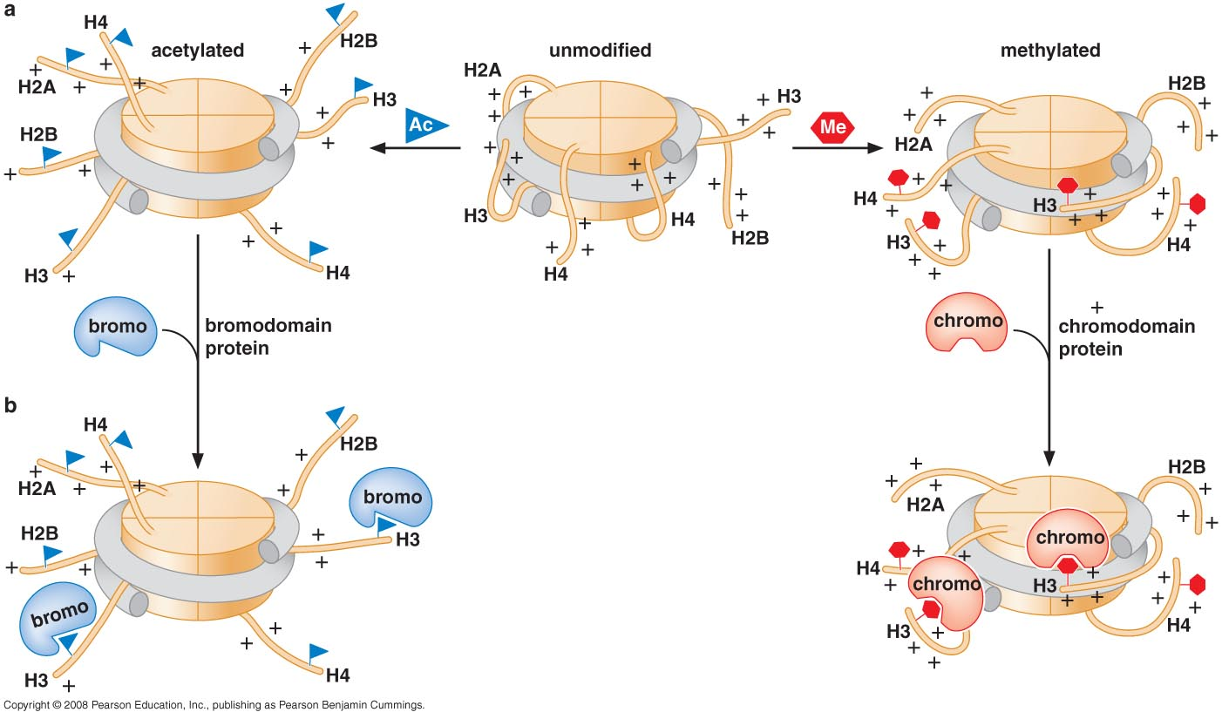
Modification of N-Terminal Tail
Unpack DNA
Create binding sites to recruit proteins (TF, mediators,…)

Slide 18
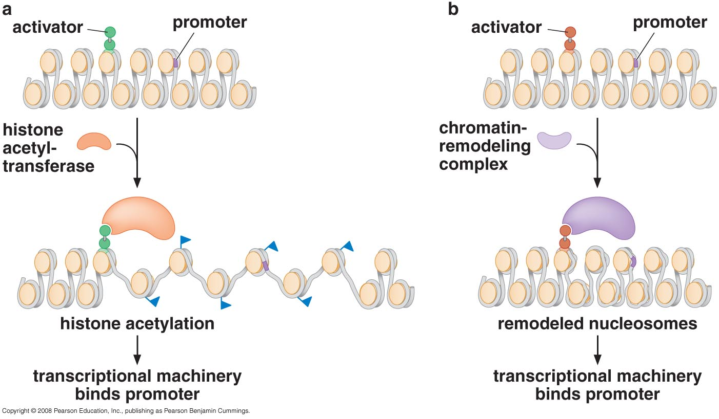
Activator recruits nucleosome modifiers

Slide 19
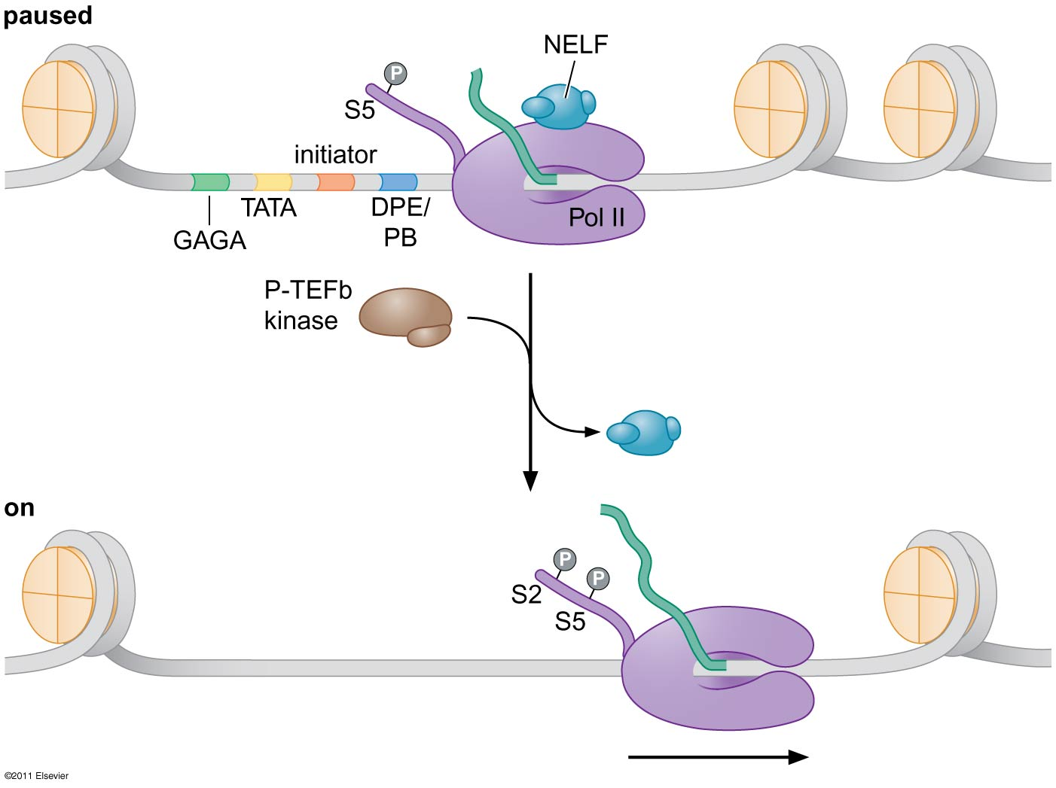
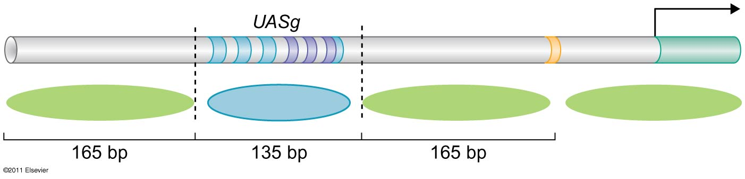
Pausing and Release of RNA pol II
RSC complex helps Gal4 activates efficiently in the face of the nucleosome

Slide 20
Is there a specific nucleosome modifier or TF for each gene
Different genes are transcribed by recruiting different combinations of transcription factors or modifiers
  Some TF are essential of some genes but not others
How much does the gene need that particular modifier (acetylase) also depends on the stage the cell at (mitosis)

Slide 21
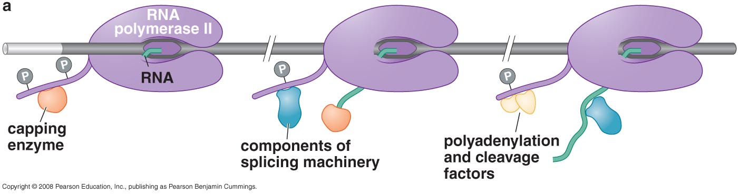
Activator recruits factors for efficient initiation & elongation
Some genes are stalled after initiation because of specific sequences in DNA
Activators recruit kinases (elongation factors) to phosphorylate CTD and free RNA polymerase
Presence of EF is important to determine the transcription rate

Slide 22
Examples of control using elongation factors
HSP70 gene:
  GAGA binding factor for initiation (recruit RNA polymerase to DNA)
  HSF activator to recruit P-TEF (positive transcription elongation factor) to CTD → free enzyme from stall
HIV genes
  SP1 activator for initiation
  TAT activator bound to viral RNA transcribed recruits P-TEF → free enzyme from stall

Slide 23
Problems arises when activators bind 100s Kb away from promoter
How can it recruit proteins to the promoter while it is very far?
  Proteins that bind to several sites of DNA creating several small loops (Chip)
  Nucleosome modifications make it very compacted so that it is not that far
  Chromatin may form special structures to bring enhancer and promoter closer together
Would it activate genes within this distance?

Slide 24
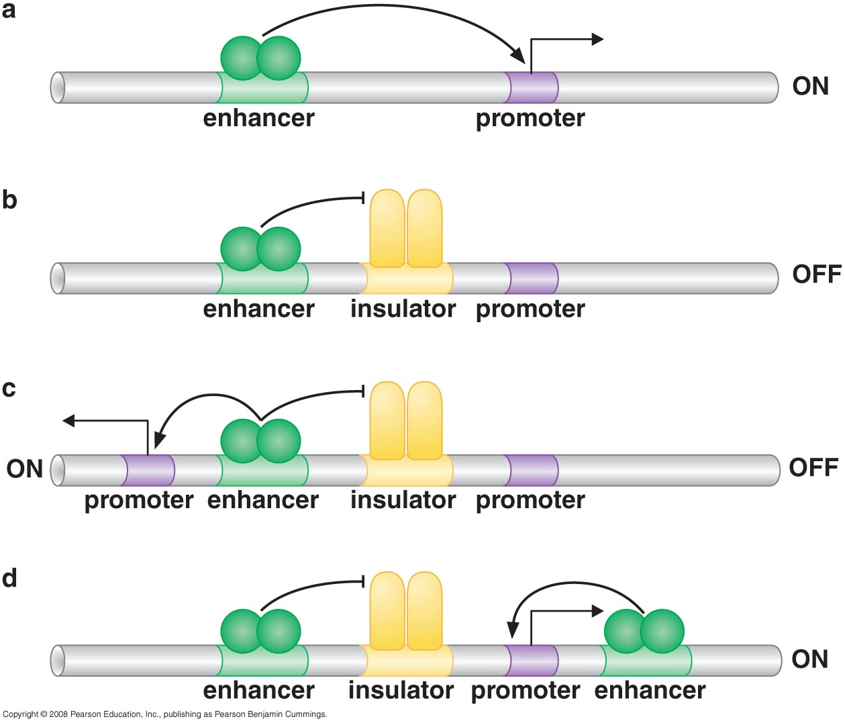
Insulators control the actions of activators
Insulator blocks communication BUT does not alter the activity of activator or repressor
Insulator inhibits spread of silencing

Slide 25
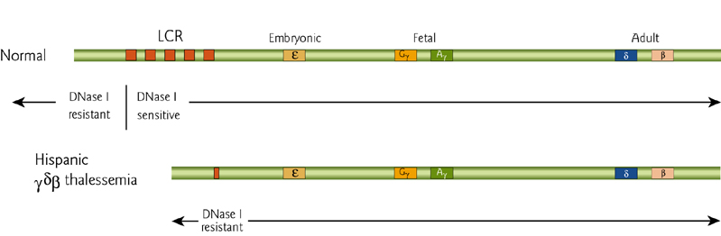
How to control activation of a gene among a cluster?
Some genes occur as cluster of several genes
  β globin gene
  Human growth hormones
  Major histocompitability complex (MHC) gene
These genes need a locus control region (LCR)

Slide 26
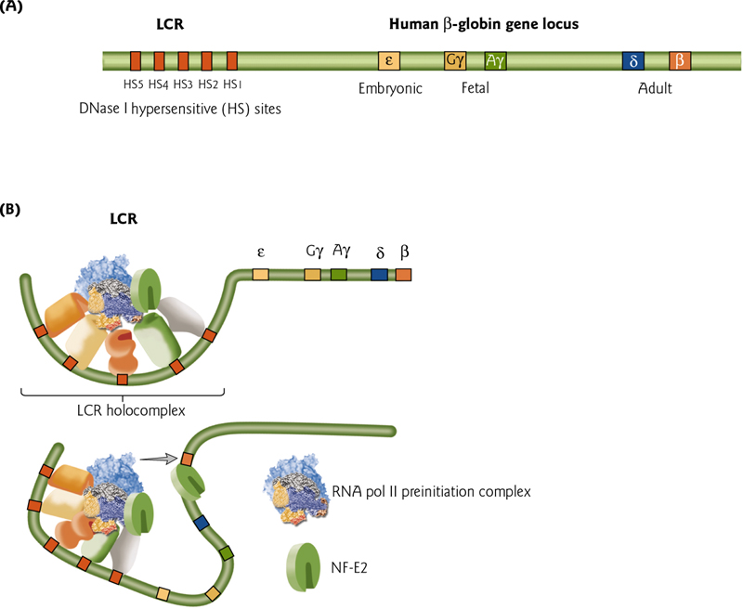
LCR
RNA polymerase is recruited to LCR
LCR interact with one gene promoter at one particular time

Slide 27
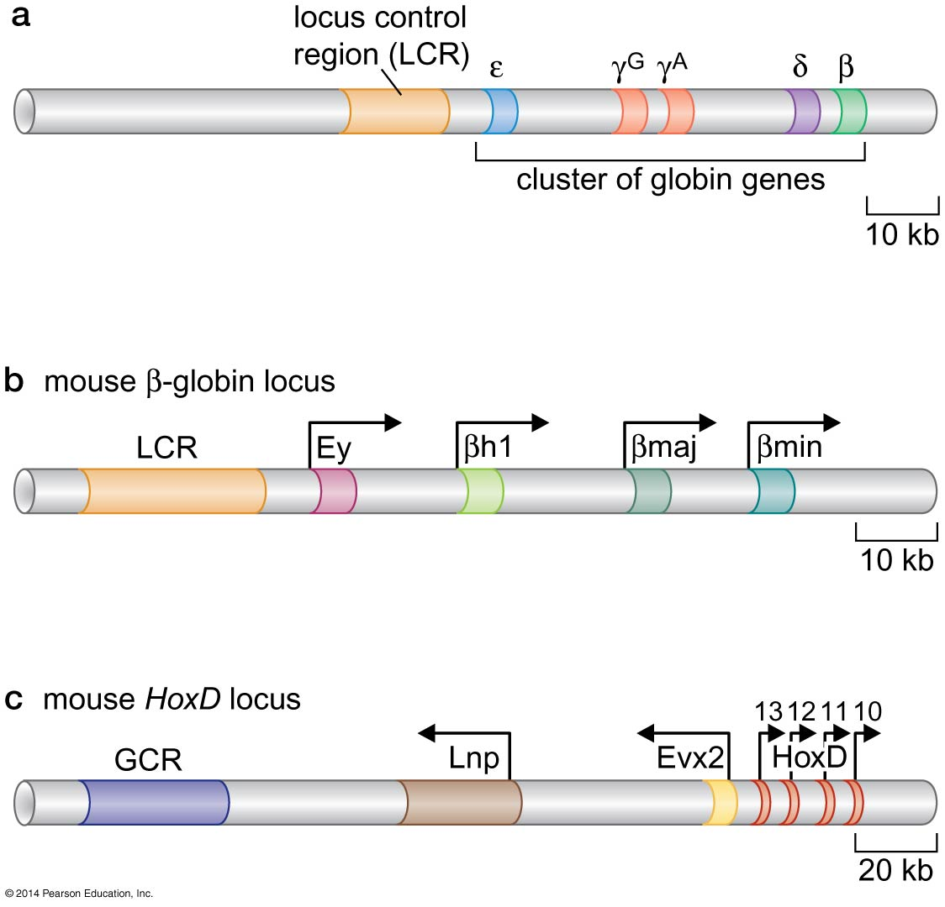

Slide 28
Activators work synergistically to integrate signals
In Eukaryotes several signals activate one gene through several activators
These activators work synergistically (multiple activators works together)
    HOW?

Slide 29
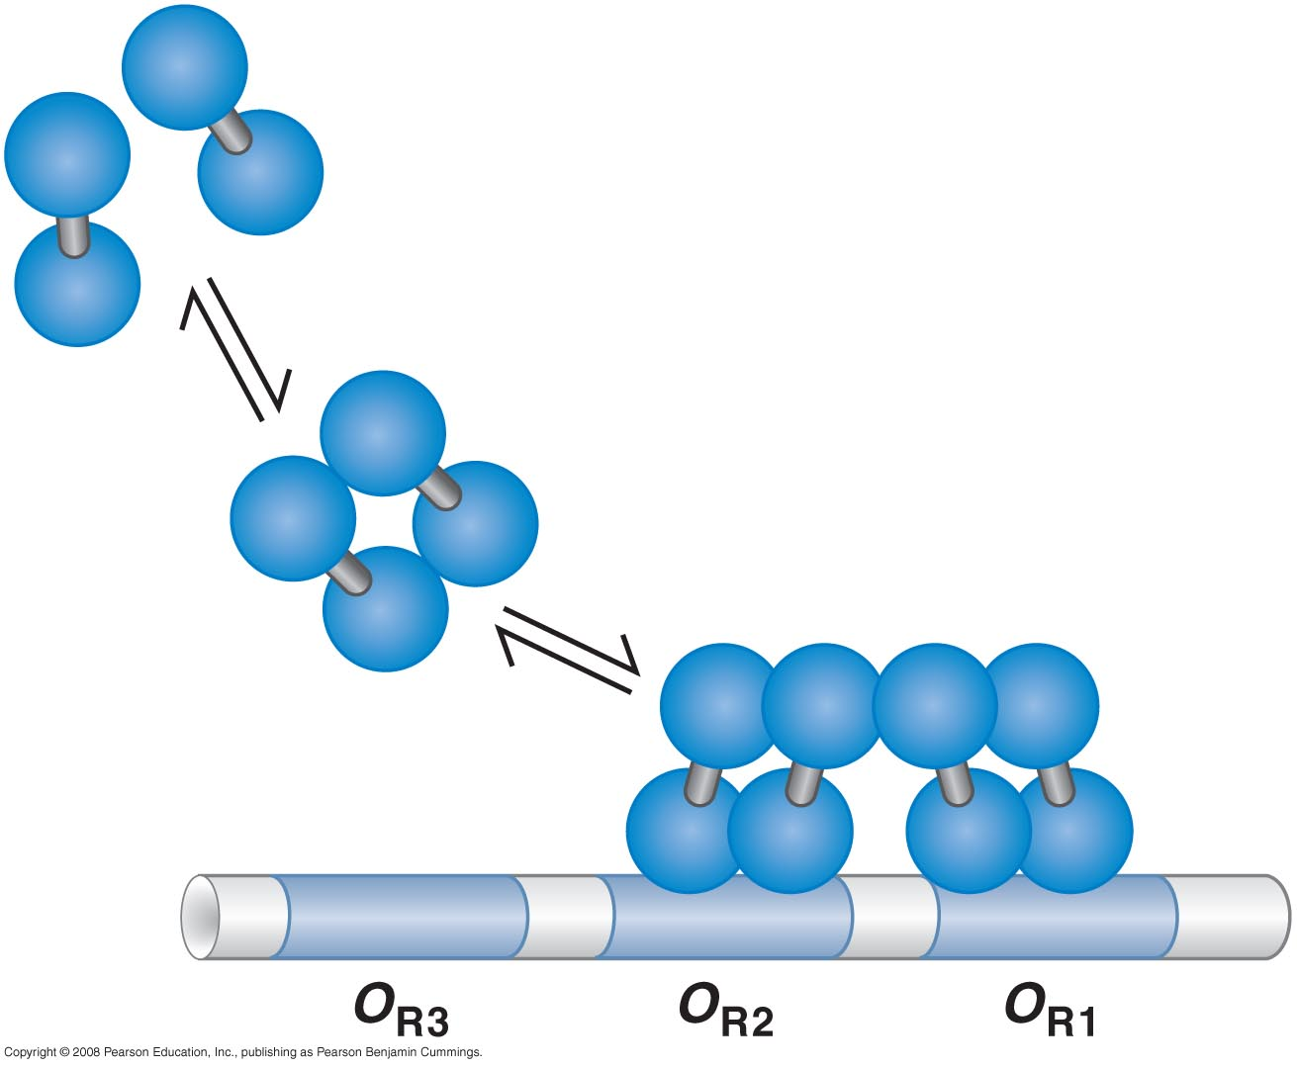
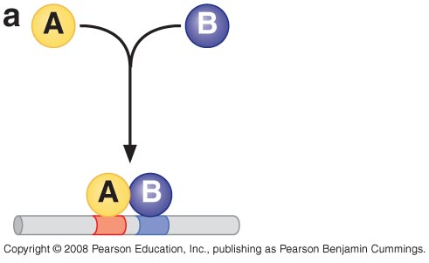
Ways of synergestic integration of activators
Direct protein – protein interaction

Slide 30
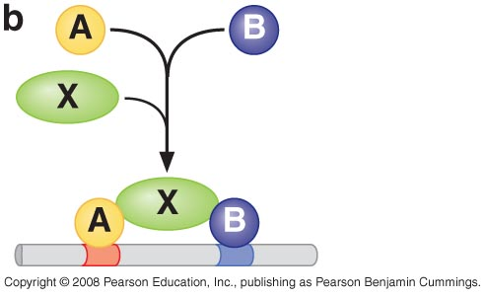
Ways of synergestic integration of activators
Two activators recruiting one complex (mediator)

Slide 31
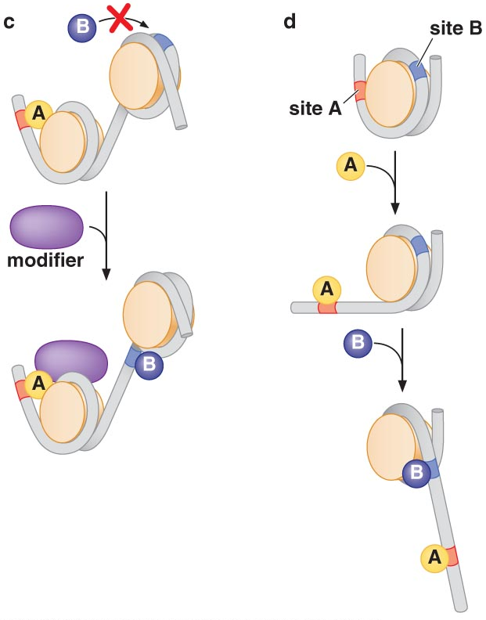
Ways of synergestic integration of activators
Cooperativity (binding through direct interaction)

Slide 32
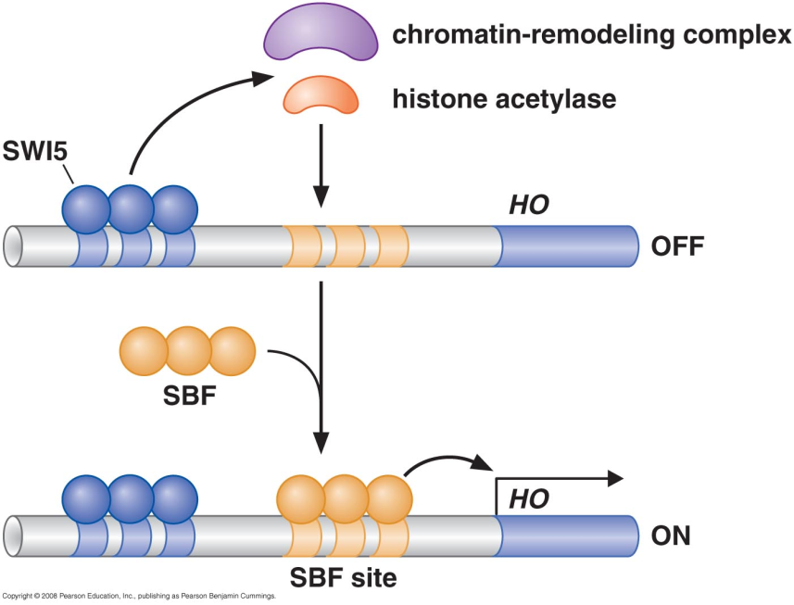
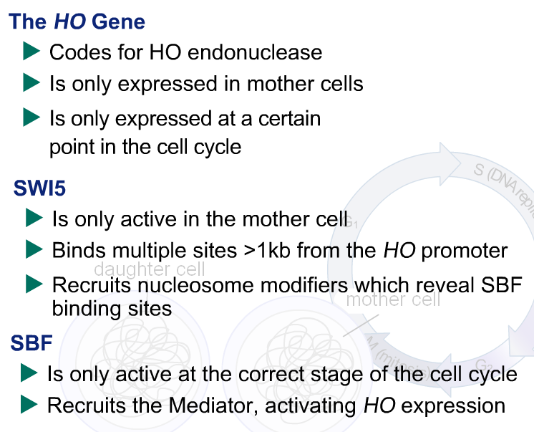
Example 1 of cooperative binding

Slide 33
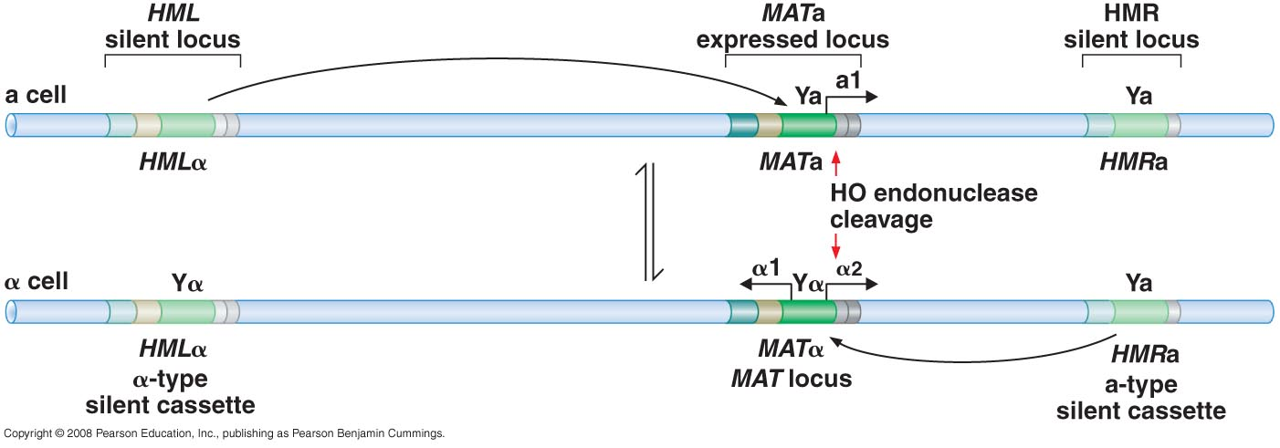
Remember:
Genetic loci encoding mating-type information
Mating type switching takes place between two sister chromatids (after replication) in the mother cells, the aim is that only haploid cells with different type can mate (a and alpha) so mother cell need to switch its type so that it can mate with its bud if needed

Slide 34
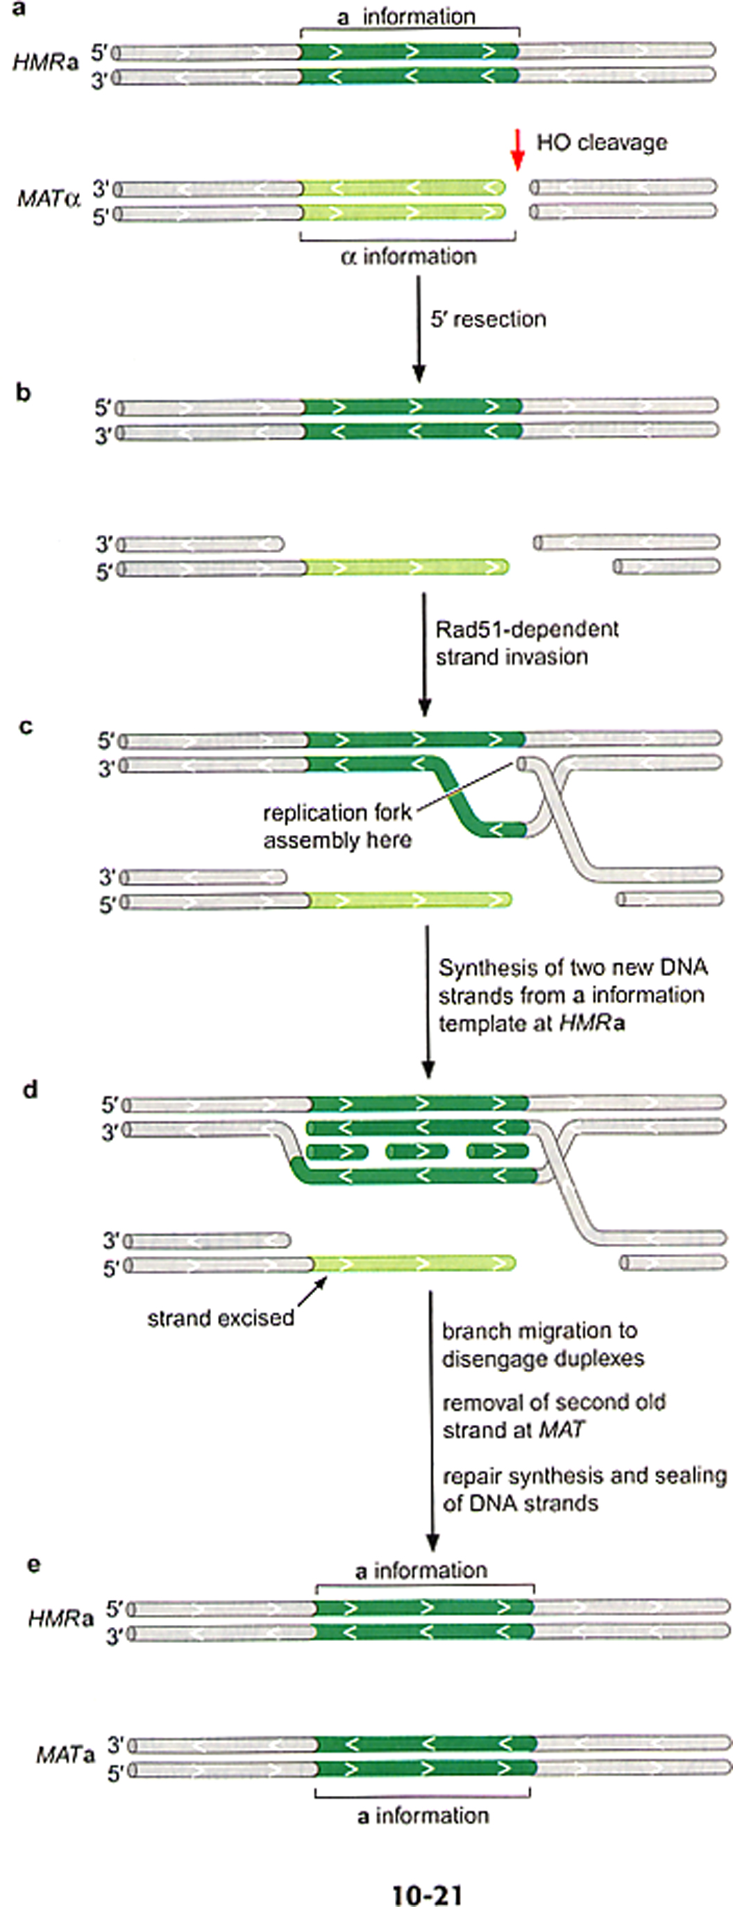
Remember:
Mating – Type Switching
HO endonuclease
  Expression is tightly regulated
  Initiate DSB at MAT locus NOT HMR/HML
  NO covalent bond with DNA
MRX protein
  5`→3` resection

Slide 35
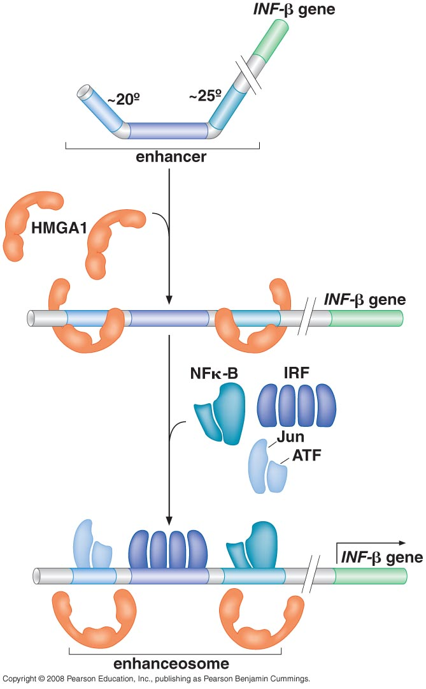
Example 2 of cooperative binding
To turn human β-interferon gene on:
  3 activators:NF-κB, IRF & Jun/ATF
  HMGA1 binds to minor groove and straighten DNA
This forms enhanceosome

Slide 36
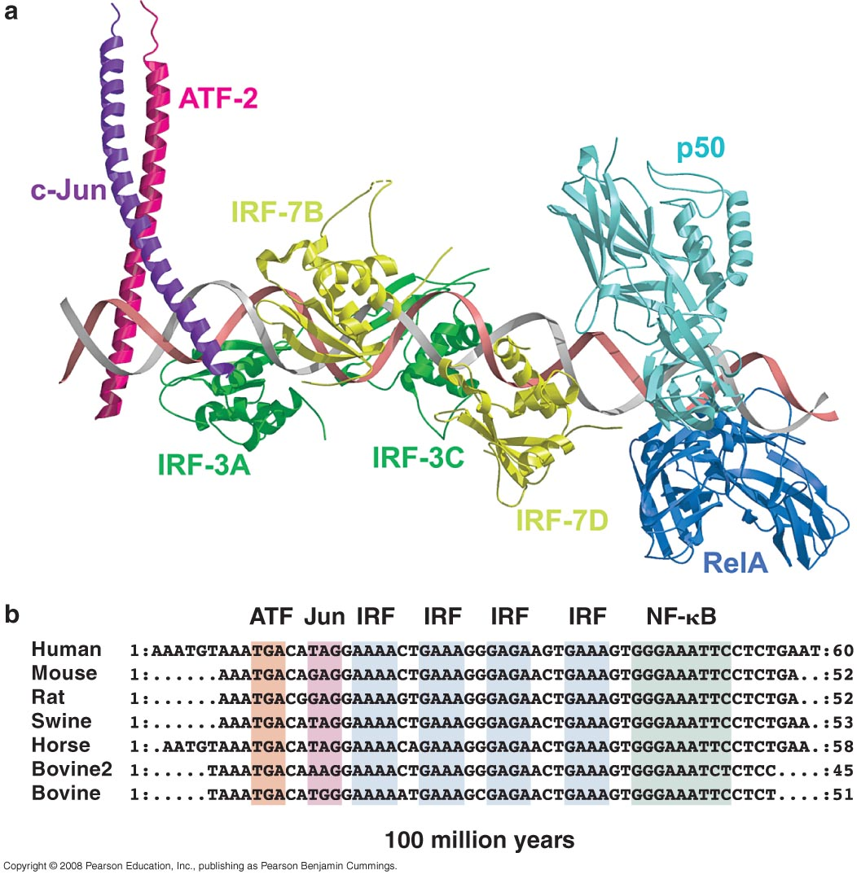
Example 2 of cooperative binding
Enhanceosome
↓
Recruits the co-avtivator (CBP)
↓
Recruit nucleosome remodeling protein
+
Transcriptional machinery

Slide 37
Combinatorial control and signal transduction

Slide 38
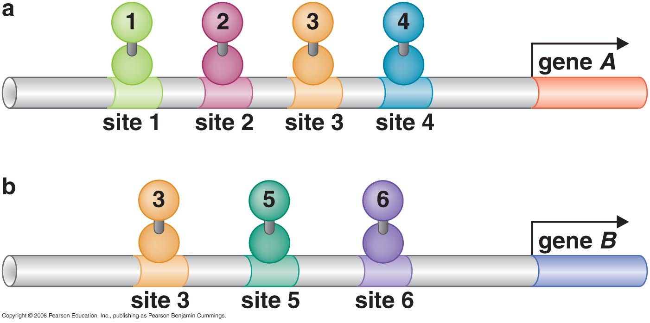
Combinatorial control of activators
Different combinations of a group of activators control different genes
  NF-κB controls both β interferon gene & Ig κ light chain

Slide 39
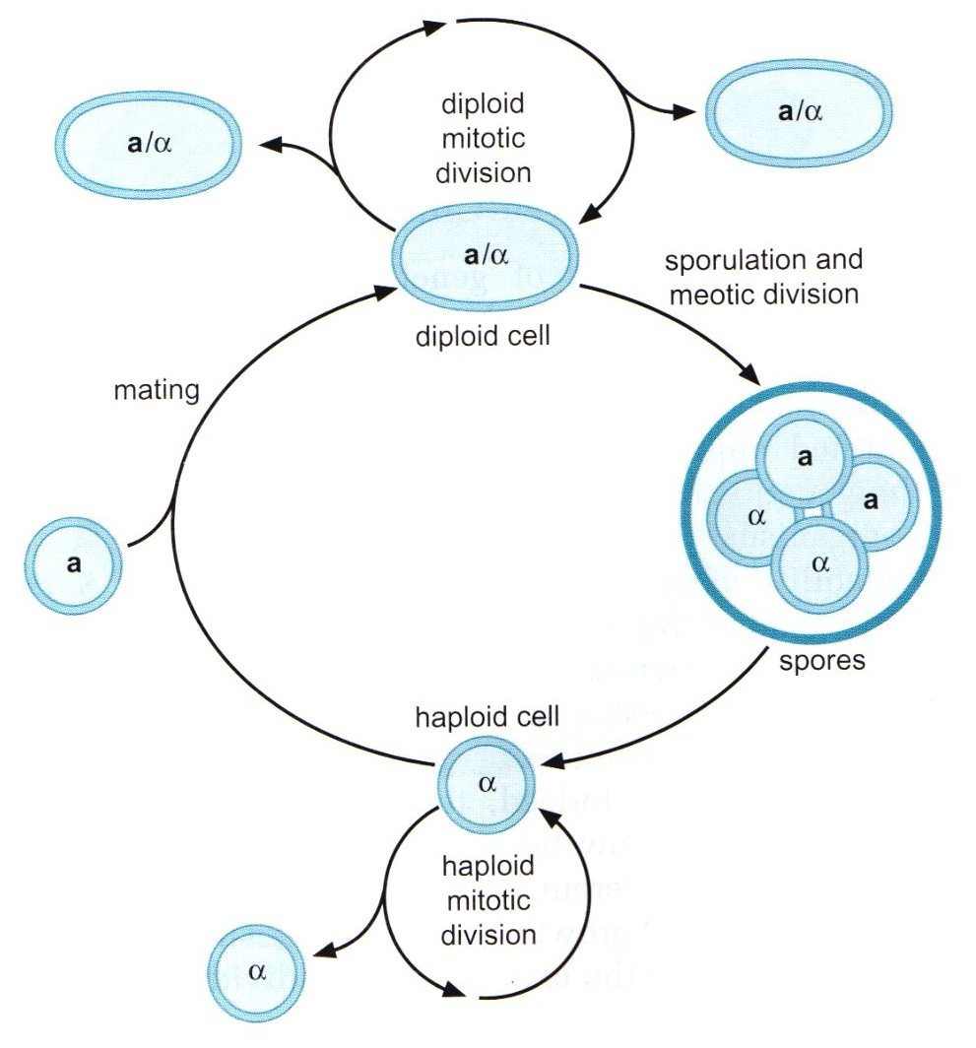
Example of combinatorial activation in mating type gene in S. cervisiae
Exist in any of 3 cell type:
  Haploid
    a
    α
  Diploid
Type is determined by Mating Type Locus (MAT)

Slide 40
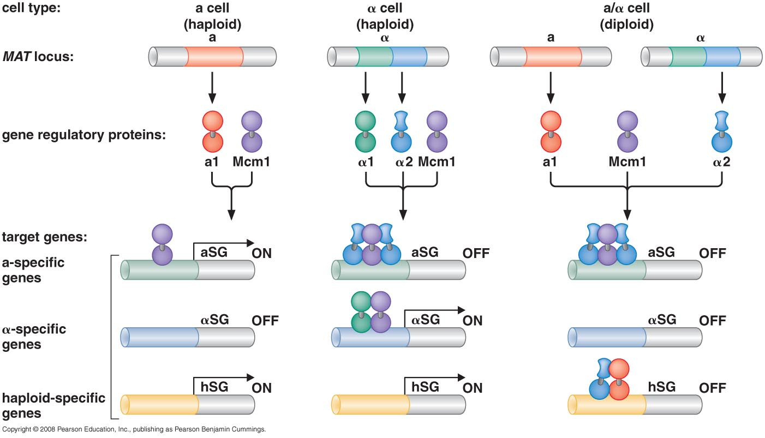
Example of combinatorial activation in mating type gene in S. cervisiae

Slide 41
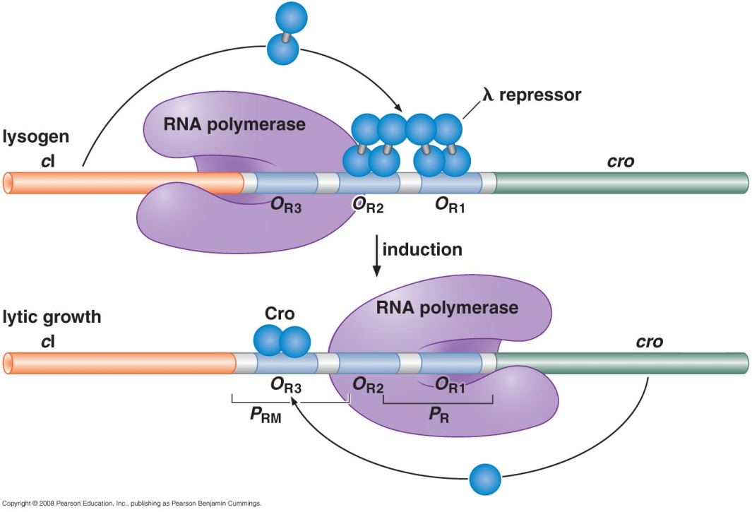
Transcriptional repressor in prokaryotes
Binding to sites overlapping promoter (most common)
Interfere with activator
The protein holds the promoter in a conformation incompatible with transcription initiation. (the MerR case)
Blocking the transition from the closed to open complex. (E.coli Gal repressor)
Preventing RNA polymerase from escape by binding close to strong promoter and binding with RNA polymerase

Slide 42
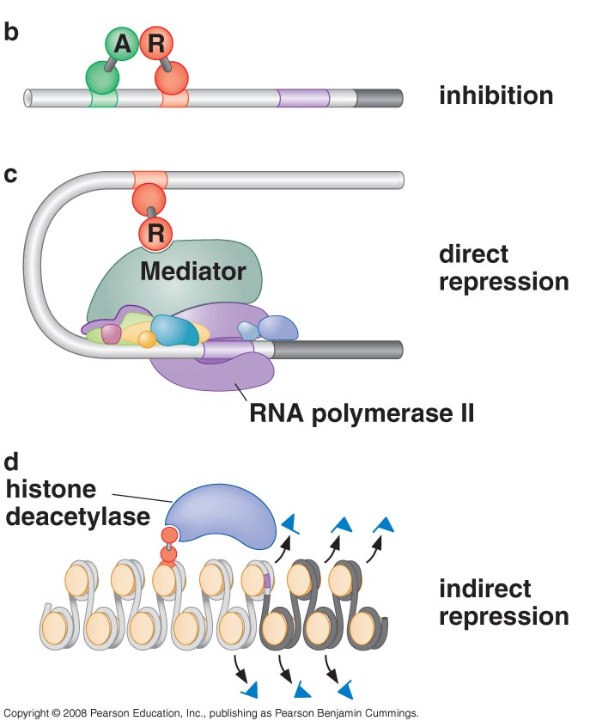
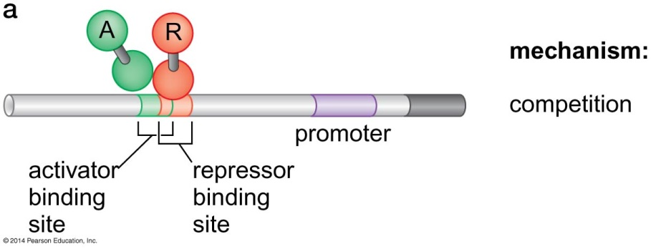
Transcriptional repressor in Eukaryotes
Competition is not common
DNA & nucleosome modifications are common:
  Histone deacetylase
  Methyl transferase

Slide 43
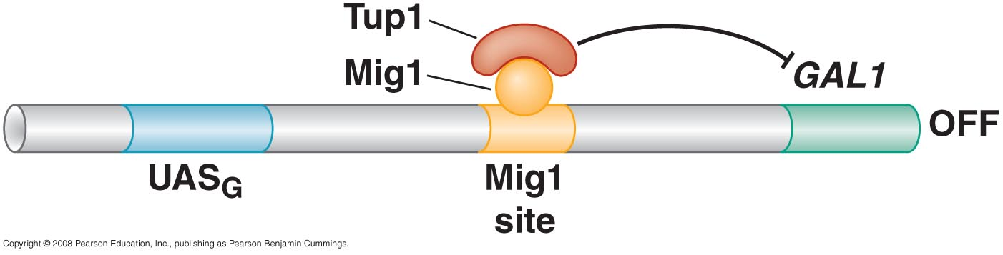
Example of repression: GAL1 gene by Mig 1 repressor
Glucose available → no need to GAL1 → Mig1 protein recruited to Mig1 site → recruit Tup1 protein
Tup1 is a repressor act by
  Recruiting histone deacetylase
  Directly contacting & inhibiting transcriptional machinery

Slide 44
What turns the gene on?
Signal
  Small molecule (sugar)
  Protein released by one cell and received by the other through cell surface receptor
This signal could affect the regulator
  Directly : allosteric change in the regulator (allolactose)
  Indirectly through a cascade of events (signal transduction pathway)

Slide 45
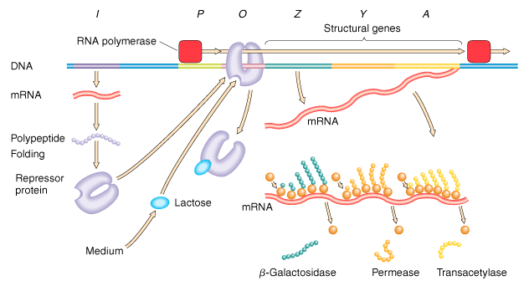
Example of direct signalling by allosteric changes in prokaryotes

Slide 46
Example of a simple signal transduction in prokaryotes
Low nitrogen levels
Trigger polymerase to initiate transcription
NtrB phosphorylates NtrC
NtrC’s DNA-binding domain revealed
ATP hydrolysis and conformation change in polymerase
NtrC binds four sites located ~ 150 base pairs upstream of the promoter
NtrC interacts with σ54

Slide 47
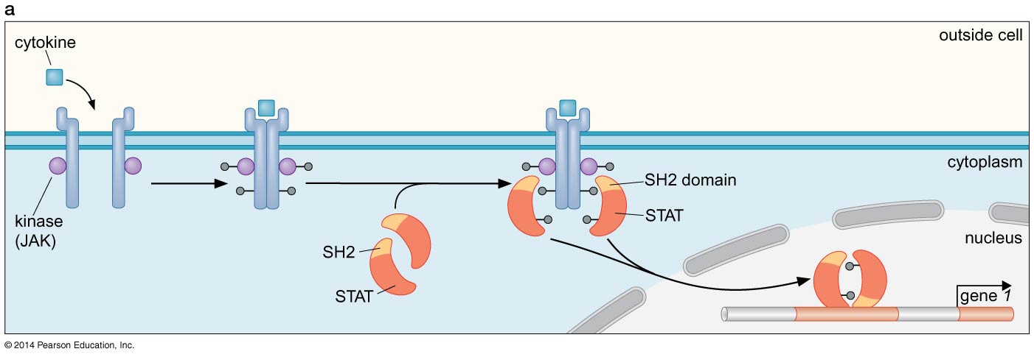
Example 1: signal transduction pathway
STAT pathway (signal transducer & activator of transcription)
Cytokine binding brings two receptors together
Activate kinase
Each SH2 domain of STAT protein recognize specific phosphorylated aa

Slide 48
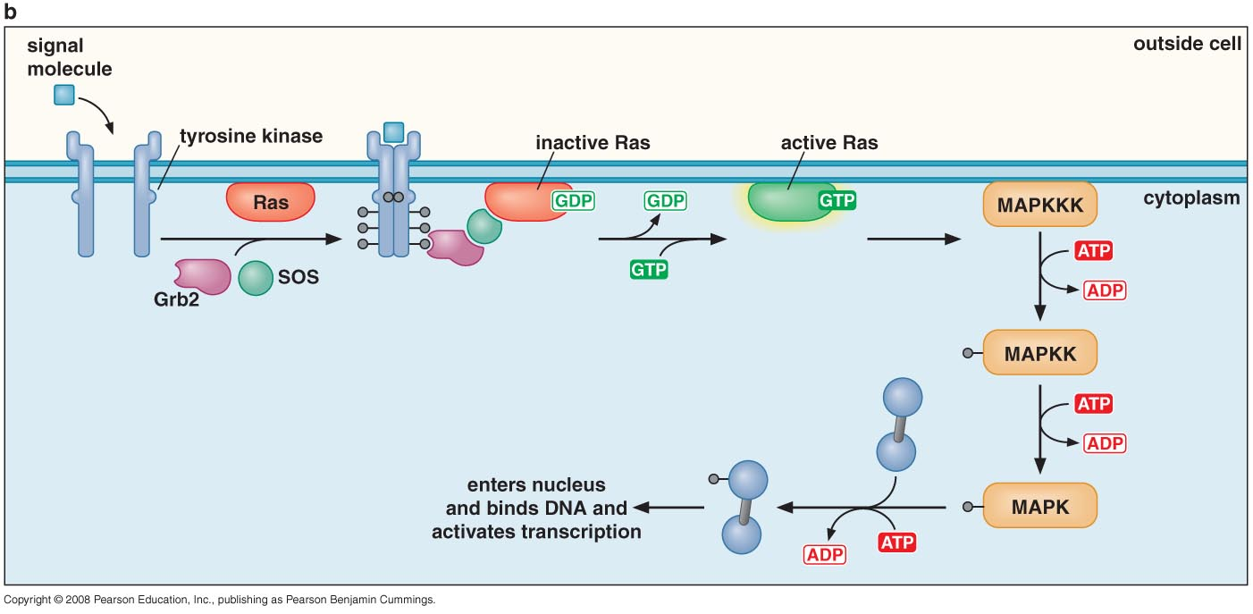
Example 2: signal transduction pathway
Ras pathway
(EGF)
(MEK)
Phosphorylation of the receptor recruit Grb2 protein
SOS is a guanine nucleotide exchange factor
Active Ras activate MAPK kinase kinase by phosphorylation

Slide 49
What does this signal do to the regulator to make it active or not?
In prokaryotes and single cellular eukaryotes: signal induces an allosteric change in the regulator
Higher eukaryotes:
  Unmasking activating region
    Conformational change revealing buried activating region
    Release masking protein
  Transport into and out of the nucleus

Slide 50
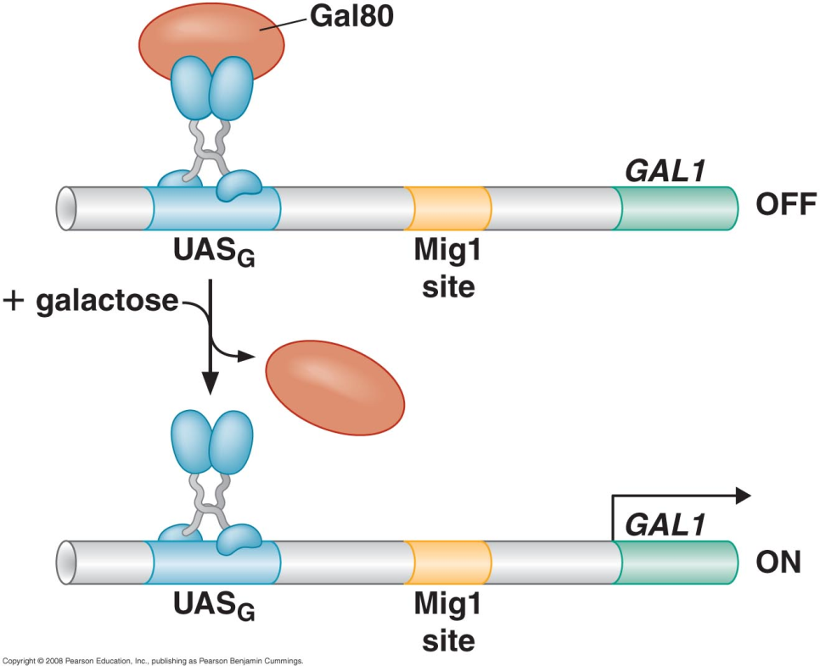
Unmasking activating region Example 1:releasing masking protein
No galactose:
  Gal80 bind to Gal4
    Masked Gal4 active site
    Recruits deacetylase
  GAL1 is off
Galactose:
  Release of Gal80
  GAL1 is on

Slide 51
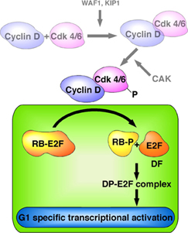
Unmasking activating region Example 2:releasing masking protein
Rb:
  Retinoblasmtoma repressor
  Repressor control E2F activity
  When phophorylated, it release E2F and allow it to activate target gene
  Phosphorylated Rb control proliferation in these cells
E2F:
  Activate genes required to get the cell into S phase

Slide 52
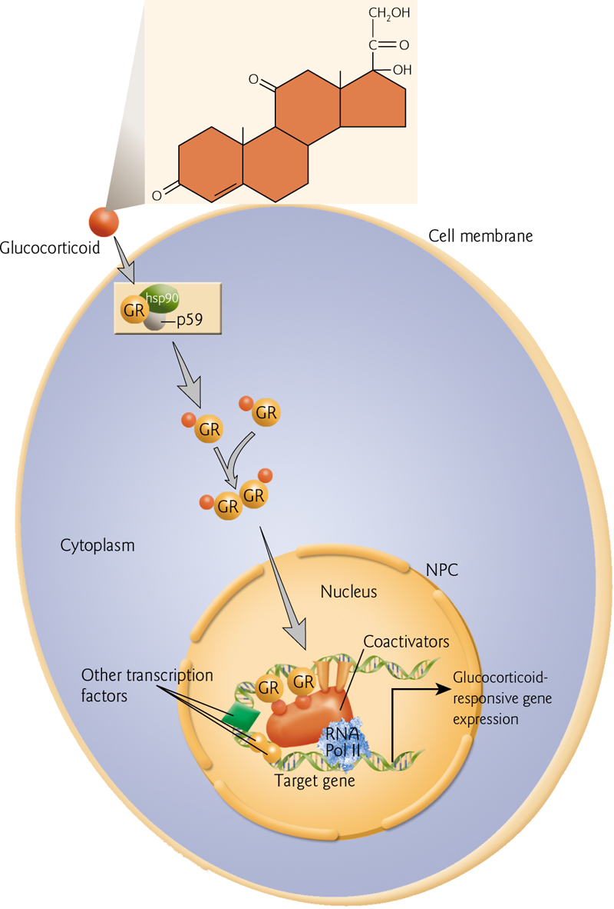
Transport into/out of the nucleus
Example: glucocorticoid receptor
Glucocorticoid (cortisol) does not need a cell receptor because it is lipophilic and pass easily cross the membrane.
Receptor is cytoplasmic
  Bound to Hsp90 when no cortisol
  Bound to crotisol when available
GR-cortisol dimer get into nucleus
Bind to GREs
Act as coactivator / corepressor

Slide 53
Gene silencing
&
Epigenetic regulation

Slide 54
What is the difference between repression & silencing
Repression
Localized to a specific gene
In response to signal
Conducted by repressor
That particular gene is targeted for repression
Silencing
Spread over large stretch of DNA
Not in response to signal
Conducted by methylases
Silencing target position of DNA not gene

Slide 55
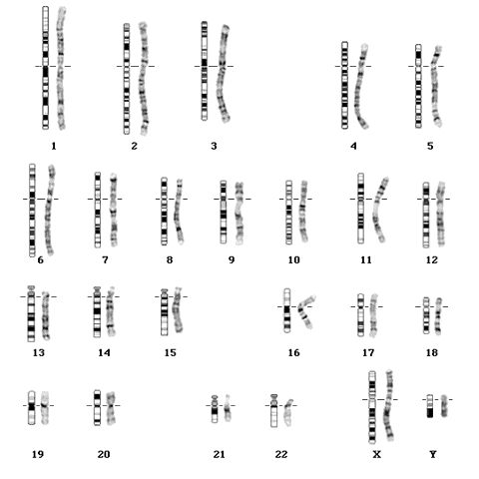
How is silencing seen?
Silenced (untranscribed) genes are compacted → dark stained → Heterochromatin
Actively transcribed genes are released → light stained → Euochromatin

Slide 56
Heterchromatin is formed by:
Histone modifications
  Deacetylase
  Methylation at specific locations (Lys-9 in H3 tail)
DNA methylation
  Not found in yeast but common in mammalian
  Inhibit binding of proteins (transcriptional machinery)
  Create binding sites for repressors

Slide 57
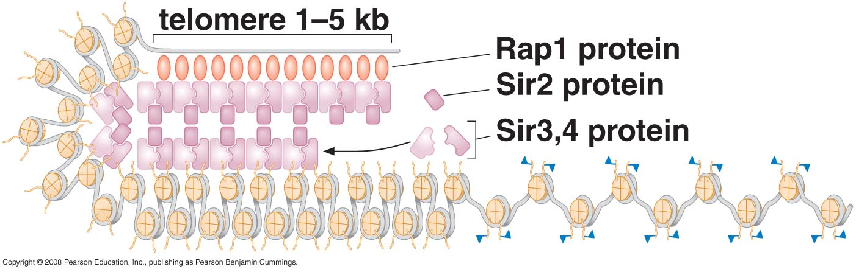
I- Silencing in yeast
Silencing is regulated by three genes: silent information regulator 2 (SIR2), SIR3, SIR4
  Sir2: histone deacetylase
  Sir3, sir4 DNA binding protein
These proteins recognize telomere by Rap1 protein that binds to telomeres only

Slide 58
How to prevent spreading of silencing
Insulator
Histone modifications prevent Sir2 protein binding

Slide 59
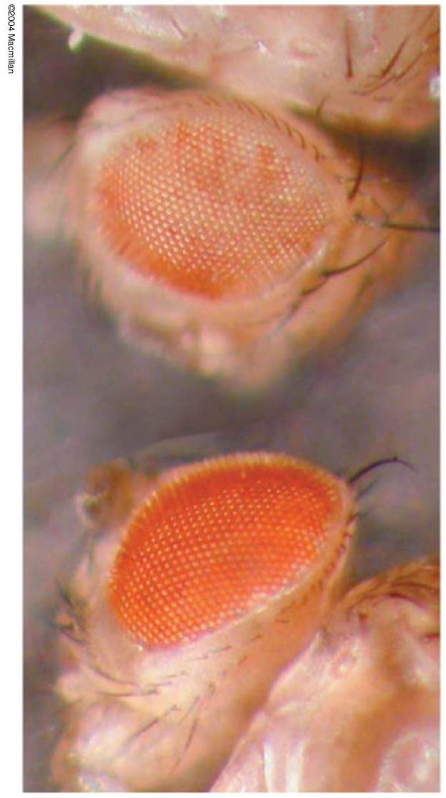
II- Silencing in Drosophila
Is presented by difference in eye color of drosophila (red, mixed, white)
“White” gene is responsible for the red color of eye
This gene is located at the junction between hetero/euchromatin
Some times it is silenced others is expressed
This causes variegation

Slide 60
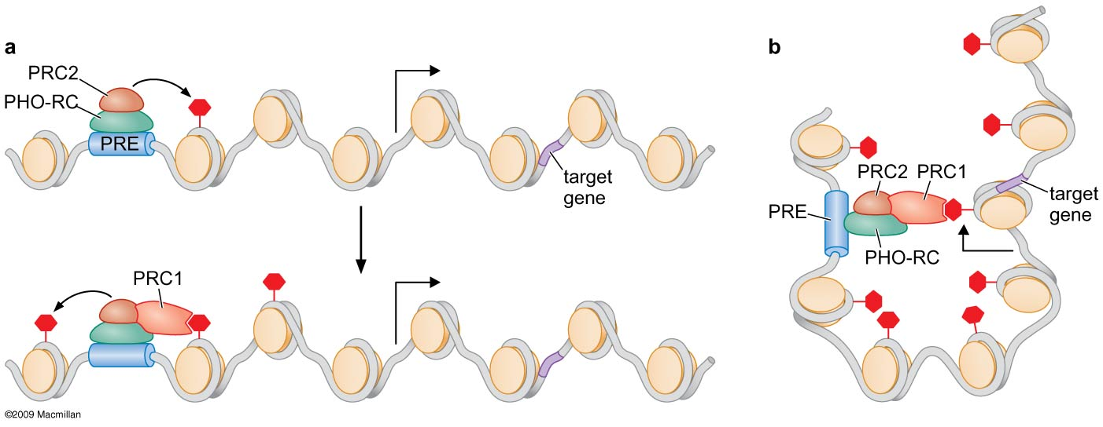
Figure 19-29
Histone Methylation and Polycomb gene Repression
Notes:
Figure 19-29
©2009 Macmillan http://www.nature.com/nrm/index.html

Slide 61

II- Silencing in Drosophila
Variegation is prevented by a suppressor of variegation protein (Su(Var)3-9)
Su(Var)3-9 is a methyl transferase (H3-Lys9)
Heterochromatin protein 1 (HP1) is a non-histone chromosomal protein
HP1 binds to chromatin with Met in H3
This prevents variegation

Slide 62
II- Silencing in Drosophila
If white gene is within euochromatin → expressed → red eyes
If white gene is within heterochromatin → not expressed → white eyes
If white gene is at junction (part in euo and other in hetero → variegation → prevented by Su(Var)3-9 → methylation of parts in Euochromatin → not expressed → uniform white eyes

Slide 63

III- Silencing in Mammalian cells
Mainly achieved by DNA methylation
MeCP2

Slide 64

DNA methylation is the reason for a phenomenon known as imprinting
In a diploid cell both copies (maternal & paternal) are expressed
Few locations (80 genes) only one copy is active and the other is silenced by methylation
For normal function the particular paternal/maternal should be functioning not the other

Slide 65

Establishing and maintaining genomic imprinting
Imprinting is controlled by imprinting control region (ICR)
Silent alleles of imprinted
loci are targeted for methylation
& protected from global
demethylation
Imprinting is reset in germline

Slide 66

Example of gene imprinting human H19 and Igf2 genes
ICR is high GC DNA sequence
Provide binding site for CTCF insulator
Methylated ICR can’t bind with CTCF

Slide 67

Beckwith-Wiedemann syndrome (BWS)
Caused by biallelic expression of Igf2 and no expression of H19 because of methylation of ICR in both chromosomes
Clinical presentation
  Overgrowth (Igf2 is a fetal growth factor)
  Macroglossia
  Hypoglycemia
  Failure of abdominal wall closure
  Increased susceptibility to cancers (H19 is regulatory RNA involved in tumor suppression)

Slide 68
Epigenetics
Epi = “out side of” or “in addition to”
Studying regulatory information beyond the level of genetic code
Regulating the gene (on/off) without the presence of direct or indirect (signaling) regulation is known as epigenetic
Imprinting, X inactivation are types of epigenetics

Slide 69

Example of epigentic regulation: Bacteriophage λ
Good conditions
Poor conditions

Slide 70

Lytic growth or lysogenic depend on which gene is expressed
Lytic growth
Lysogenic growth
Both CII & Cro are transcribed
If growth is good → CII protein is damaged quickly → no activation of CI → no repressor synthesized → lytic growth
If growth is poor → CII protein is damaged slowly → activation of CI → λ repressor synthesized → lysogenic growth

Slide 71

Maintaining growth mode
Once growth mode is determined it would not change (Epigenetic regulation)
How this is maintained?
Auto regulation

Slide 72

Maintaining growth mode

Slide 73

Example of epigentic regulation:
Maintenance methylase target hemimethylated DNA to maintain methylation

Slide 74

Example of epigentic regulation:
Maintaining histone modification

